Slide 1
CSEE5590/CS490-0004: AI for Cybersecurity
Gharib Gharibi
Summer 2019

Slide 2
Inference and Validation
Inference: using a trained DNN to make predictions.
Validation: testing(validating) the performance of the trained DNN.
The “performance” is based on the application. It could be the accuracy (the percentage of correct predicted outputs), the precision, the recall, top 5-error rate, etc.

Slide 3
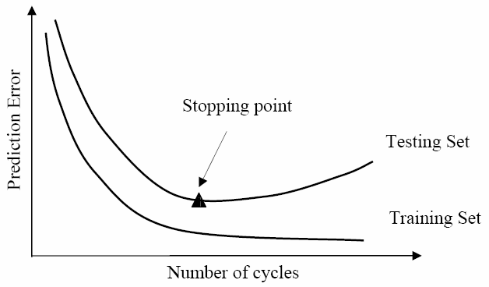
Overfitting
DNN have a tendency to perform too well on the training data and aren't able to generalize to data that hasn't been seen before (validation dataset).

Slide 4
Regularization
A measure to reduce the network’s overfitting. It can use several techniques. In this exercise we will use the technique of Drop Out to reduce overfitting.

Slide 5
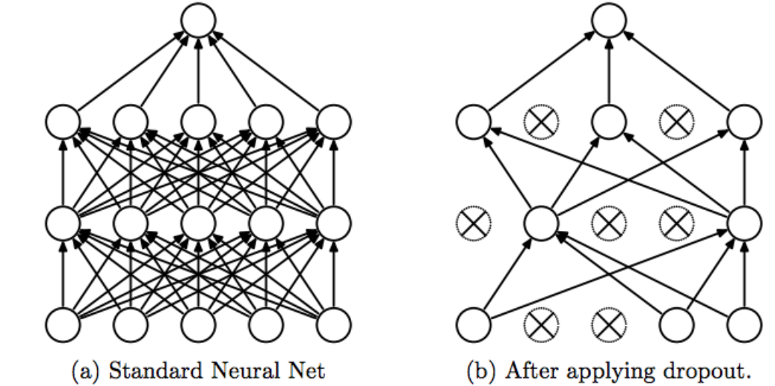
Drop Out
A measure to reduce the network’s overfitting by dropping out (ignoring) a number of hidden, and visual, neurons in the DNN randomly.
Learn less to learn better!
Reference: Srivastava, Nitish, et al. ”Dropout: a simple way to prevent neural networks from overfitting”, JMLR 2014

Slide 6
Inference
Make predictions using your trained network.
You can use the model.eval() function to make predictions.
Make sure to turn of the autograd

Slide 7
Saving/Loading Your Trained Model
In order to reuse your trained model or deploy it in a real environment, you need first to save your model. Saving a model means saving its architecture and weights.
The parameters for PyTorch networks are stored in a model's state_dict
torch.save(model.state_dict(), 'checkpoint.pth')
model.load_state_dict(state_dict)

Slide 8
Loading Your Own Data
Check the Notboko #7 for:
Loading data from a path
Transforms
Data Augmentation

Slide 9
ICP2 (Exercise Part5 , 6, and 7)

